Slide 1



Semester End Examination (SEE) PRESENTATION
By: Vivek Choudhary
393CS20032
BLDEA’s SHREE SANGANBASAVA MAHASWAMIJI POLYTECHNIC VIJAYAPUR

Slide 2

Content
1. Company Description
2. On Job Training – 1
3. Use Case – 1
4. On Job Training – 2
5. Use Case – 2
6. Conclusion

Slide 3

1. Company Description
OVERVIEW OF THE ORGANIZATION
TechifyIndia is a startup company for providing IT solutions, building innovative IoT products.
Since 2017, the company have been providing consulting services, website development, design services, IoT, application development and technical support to client in various industries.
Focused on developing IoT products & services to contribute to improving our customer productivity and add value to their business.
Also work develop the project based on artificial intelligence and machine learning.

Slide 4
VISION AND MISSION OF THE ORGANIZATION
Vision is to build upon a reputation of being one of the most innovative IT solution and services provider. Which highlights the company’s commitment to providing innovative solutions to its customer.
Mission of the organization is to produce excellent services in the filed of IT services and consulting with maximum efforts drive towards customer satisfaction.
The company maximize the benefits of our depth, diversity and delivery capability, ensuring adaptability to client needs, and thus bringing out the most innovative solutions in every business and technology domain.
TECHIFYINDIA is one stop partner where you can outsource all your support services with complete peace of mind about quality and reliability.

Slide 5
ORGANIZATION STRUCTURE
The organization works under a functional structure, with several departments and divisions responsible for different aspects of the company’s operations.
It is characterized by the divisions of the company into different functional areas, such as marketing, finance, operations, and human resources.
Each function area is headed by manager who oversees the activities of their team. This structure is simple and effective.
The executive team consists of 12 member, with CEO being the highest-ranking member of the organization.
The department within the organization include marketing and sells, Development, testing, and services providing team, with each department being headed by the department manager.

Slide 6
ROLES AND RESPONSIBILITY OF PERSONNEL IN ORGANIZATION
The roles and responsibility of personnel within the organization vary depending on their job functions and departmental affiliations.
Some of the common roles within organization include CEO, Marketing management, Developers, H-R management, etc.
The personnel within the organization are expected to the company values and principles while carrying out their duties.

Slide 7
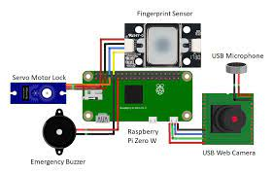


PRODUCT AND MARKET PERFORMANCE
List of the products of TechifyIndia
Cashew Soft ERP
TAX-E(GST Billing)
CNC Monitoring
IOT based smart Bell

Slide 8
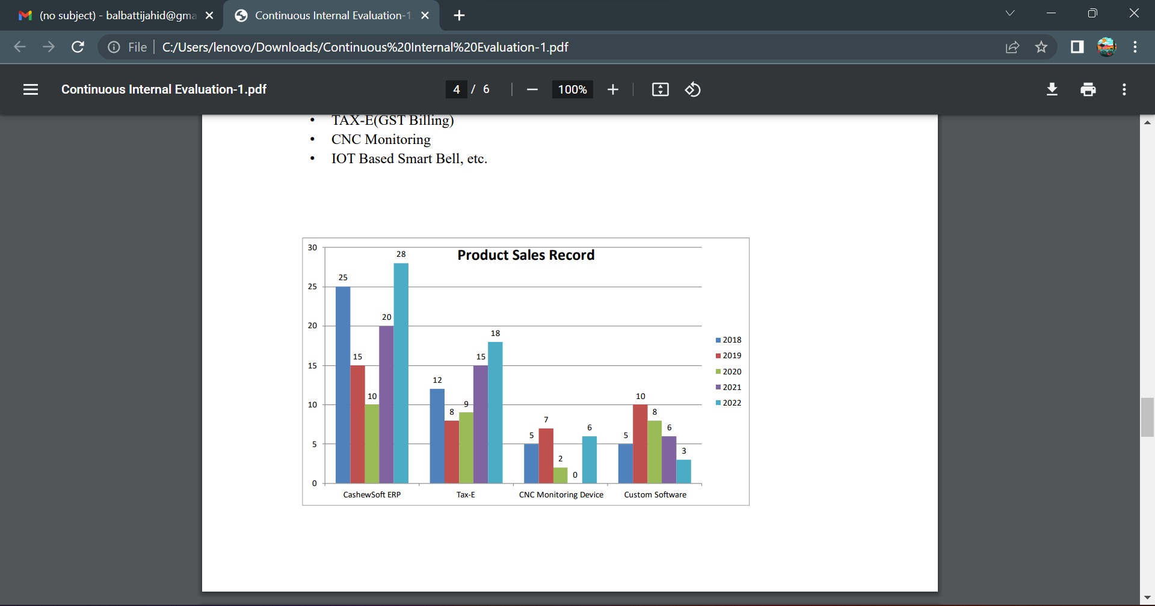
Product sales Record of TechifyIndia

Slide 9
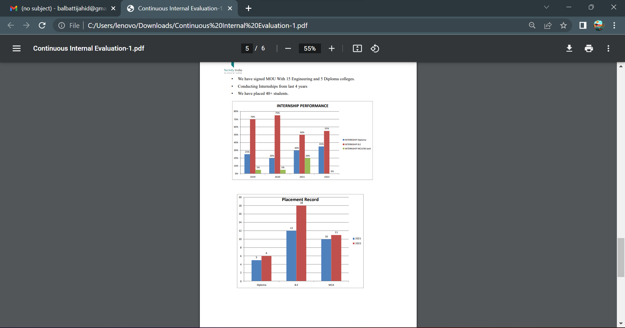
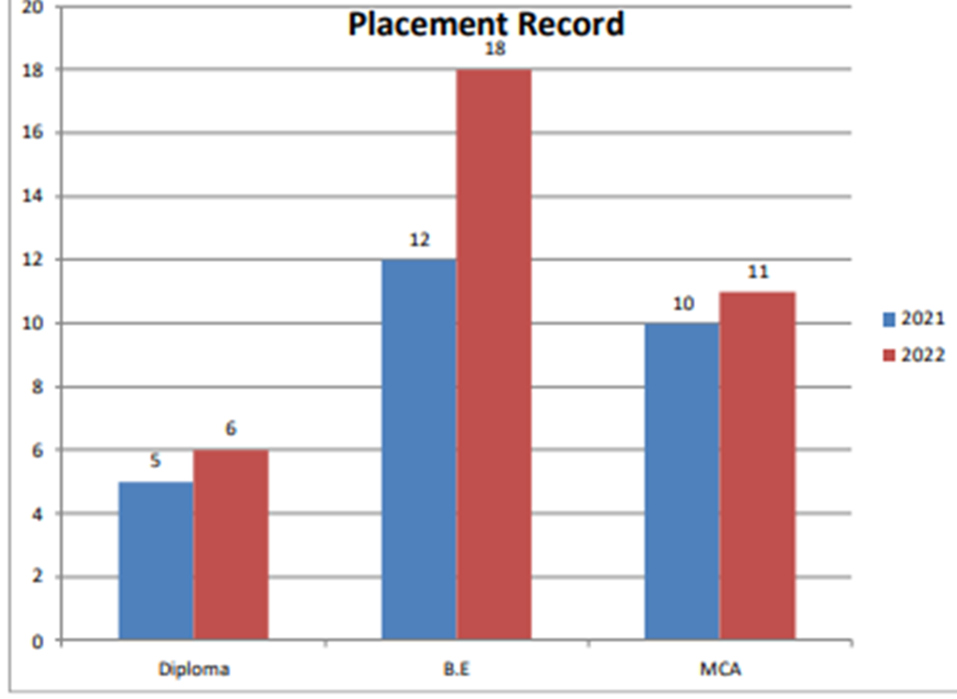
We have signed MOU with 15 Engineering and 5 Diploma Colleges
Conducting internship from last 4 years
We have placed 40+ students

Slide 10
2. On Job Training - I
PYTHON PROGRAMMING WITH OOP’s
Python is an high-level, interpreted programming language that emphasize code readability and simplicity.
Python is known for its elegant syntax and easy-to-understand code, making it a popular choice for beginners and experienced developers.
It supports various programming paradigms, including procedural, functional, and object – oriented programming (OOP)
Python programming with an emphasis on OOP principles, concepts, and implementation.

Slide 11
OBJECT ORIENTED PROGRAMMING (OOP)
Object oriented programming is a programming paradigm that provide a structure way to design and build software.
Classes and object : In oop, a class representation a real-world entity. It defines the structure and behavior that objects of that class will possess. Object is an instance of class representing a specific entity
Encapsulation : encapsulation is a function principle of oop that combines data function into a single unit called a class.
Inheritance : inheritance is a mechanism that allows a class to inherit attribute and method from another class, called the base class or parent class.
Polymorphism: polymorphism is the ability of object of different classes to be treated as object of a common base class.

Slide 12
IMPLEMENTATION OF OOP IN PYTHON
Classes: Define classes to encapsulate data and behavior.
Objects: Create objects (instances) of classes to represent specific instances of the data.
Inheritance: Use inheritance to create subclasses that inherit properties and methods from a parent class.
Polymorphism: Utilize polymorphism to create multiple methods with the same name but different implementations in different classes.
Encapsulation: Use encapsulation to hide the internal details of a class and provide public interfaces for interacting with the object.

Slide 13
BENEFITS OF OOP IN PYTHON
Code reusability
Encapsulation and data hiding
Abstraction and simplified complexity
Inheritance and code reuse
Polymorphism and flexibility

Slide 14
IMPORTANT FUNCTION OF PYTHON
Map: The map() function in Python is used to apply a given function to each item in an iterable
Filter: The filter() function in Python is used to filter out elements from an iterable based on a specified condition.
Reduce: The reduce() function is part of the functools module in Python. It is used to apply a specified function to the elements of an iterable in a cumulative way.
Lambda Functions: A lambda function is a small, anonymous function in Python. It is defined using the lambda keyword and can take any number of arguments but can only have one expression.

Slide 15
3. Use Case - I
BANKING APPLICATION
They enable users to perform various financial transactions and access banking services conveniently from their mobile devices or computers.
Account Management: Banking applications allow users to create and manage their bank accounts, including checking, savings, and investment accounts.
Bill Payments: Banking apps provide the functionality to pay bills directly from the application, eliminating the need for manual payments.

Slide 16
PROBLEM STATEMENT
You are tasked with creating a simple banking application. Implement a Python class called BankAccount that represents a bank account. The BankAccount class should have the following attributes and methods
Attributes:
account_number (integer): A unique identifier for the bank account.
balance (float): The current balance in the account.
Methods:
_init_(self, account_number): Initializes a new bank account with the given account number and a balance of 0.
deposit(self, amount): Deposits the specified amount into the account and updates the balance accordingly.
withdraw(self, amount): Withdraws the specified amount from the account, if the account has sufficient funds, and updates the balance accordingly.
get_balance(self): Returns the current balance in the account.
Write the BankAccount class implementation and provide a sample code snippet that demonstrates the usage of the class by creating instances of BankAccount and performing various operations on them.

Slide 17
AI IMPLEMENTATION
NLP is used to enable natural language interaction with the system, allowing users to input account numbers through an input function.
Decision-making is implemented using conditional statements to process and respond to user input.
Automation is achieved by automating banking operations like depositing, withdrawing, and checking account balances, reducing manual intervention.

Slide 18
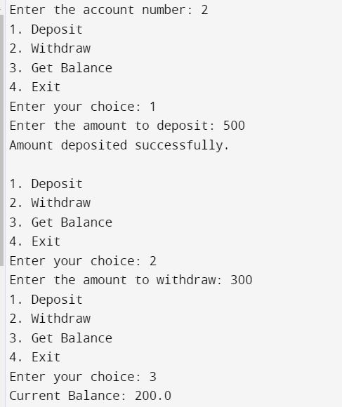
Output of program

Slide 19
4. On Job Training - II
ARTIFICIAL INTELLIGENCE
AI application include advanced web search, recommendation systems, understanding human speech, self driving cars, generative or creative tools, automated decision making, and competing at the highest level in strategic game system.
The various sub field of AI research are centered around particular goals and the use of particular tools.
The traditional goals of AI research include reasoning, knowledge representation, planning learning, natural language processing, perception, and ability to move and manipulate objects.

Slide 20
TYPES OF AI
Artificial narrow intelligence: AI designed to complete very specific actions unable to independently learn.
Artificial general intelligence: AI designed to learn, think and perform at similar levels to humans.
Artificial superintelligence: AI able to surpass the knowledge and capabilities of human.
Reactive machines: AI capable of responding to externals stimuli in real time, unable to build memory or store information for future.
Theory of mind: AI that can sense and respond to human emotions, plus perform the tasks of limited memory machines.

Slide 21
MACHINE LEARNING
Machine learning is a branch of artificial intelligence (AI) and computer science which focuses on the use of data and algorithms to imitate the way that humans learn, gradually improving its accuracy.
Machine learning is an important component of the growing field of data science.
These insights subsequently drive decision making within applications and businesses, ideally impacting key growth metrics.
Machine learning algorithms are typically created using frameworks that accelerate solution development, such as TensorFlow and PyTorch.

Slide 22
MACHINE LEARNING METHODS
Supervised machine learning: Supervised learning, also known as supervised machine learning, is defined by its use of labeled datasets to train algorithms to classify data or predict outcomes accurately.
Unsupervised machine learning: Unsupervised learning, also known as unsupervised machine learning, uses machine learning algorithm to analyze and cluster unlabeled datasets.
Reinforcement machine learning Reinforcement machine learning is a machine learning model that is similar to supervised learning, but the algorithm isn’t trained using sample data

Slide 23
OpenCV
OpenCV open source computer vision library is an open source computer vision and machine learning software library
OpenCV was built to provide a common infrastructure for computer vision application and to accelerate the use of machine perception in the commercial product.
OpenCV is an open-source software library for computer vision and machine learning.
The OpenCV full form is Open Source Computer Vision Library. It was created to provide a shared infrastructure for applications for computer vision and to speed up the use of machine perception in consumer products.

Slide 24
HAAR CASCADE DATASET
Haar cascade is an algorithm that can detect objects in images, irrespective of their scale in image and location.
This algorithm is not so complex and can run in real-time. We can train a haarcascade detector to detect various objects like cars, bikes, buildings, fruits, etc
The main concept behind the Haarcascade algorithm is to train a classifier to identify specific patterns or features in an image that correspond to the object of interest.

Slide 25
5. Use Case - II
SMART CITY MISSION
National Smart Cities Mission is an urban renewal and retrofitting program by the Government of India with the mission to develop smart cities across the country, making them citizen friendly and sustainable
The Union Ministry of Urban Development is responsible for implementing the mission in collaboration with the state governments of the respective cities.
Smart Cities Mission envisions developing an area within the cities in the country as model areas based on an area development plan, which is expected to have a ruboff effect on other parts of the city, and nearby citoes and towns.
The Smart Cities Mission is an initiative by the Government of India to improve the lifestyle of citizens living in that particular city or town.

Slide 26
FEATURES OF SMART CITY MISSION OF INDIA
The mission promotes the use of mixed land according to its per-area usage plan. Therefore, this allows the state to have vast land for multi-purposes and make the bye-laws accordingly.
Providing housing choices to everyone is another major goal of the Smart City projects.
The mission is set to give the people relief from congestion. Smart City India will also ensure the security of the people, promote communication, and reduce smog at the same time.
Developing recreational spots like gardens, parks, open gyms, playgrounds, and more are other major goals of the mission.
Government-related services are gradually going digital to promote transparency and accountability in the system and the people.

Slide 27
PROBLEM STATEMENT
Color-based Detection: Threshold the input image in the HSV color space using predefined color ranges for red, yellow, and green to accurately detect traffic lights.
Contour Extraction: Utilize contour detection techniques to identify the contours of the traffic lights in the binary masks obtained from color thresholding.
Filtering and Size-based Selection: Filter out small and irrelevant contours based on their area, using a minimum contour area threshold, to eliminate noise and improve detection accuracy.
Bounding Box Visualization: Draw bounding rectangles around the detected traffic light contours and annotate them with the corresponding color label (red, yellow, or green) for visual representation and interpretation.

Slide 28
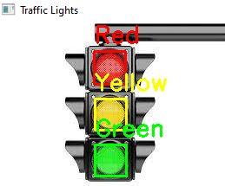
Output of program

Slide 29
CONCLUSION
In company we trained about Python, OOP’s, Python implementation with OOP, Benefits of OOP in python, important function in python like lambda, map, reduce, filter in internship .
We were assigned with Banking application using python programming language, where we used python oops, python function like map, reduce, lambda. Created an programming which accepts the input as account id and displays based on users interest of deposit or withdraw amount and to show balance
During the internship we learnt about Artificial Intelligence, types of AI, Machine learning, OpenCv, Haar cascade dataset. We learnt about OpenCV through which the system can detect through its camera like human, human face, moving object, etc.
Assigned with task which shows traffic light detection using OpenCV. Here we created a program that detect the color of traffic signals by cars. From which there will less chances of accidents .

